Slide 1







www.spex.me
00962799710001
Spex Transportation
Jordan – Amman Sweifieh Alwakalat Street
spexexps

Slide 2

WHY SPEX?!
Working closely with customers to improve their performance and
reduce costs.
Service quality assured and guaranteed.
Providing experienced and professional service.
Direct link between providers, Suppliers and our customers.
Supply chain management and shipping consolidation.
Flexible and creative service.

Slide 3
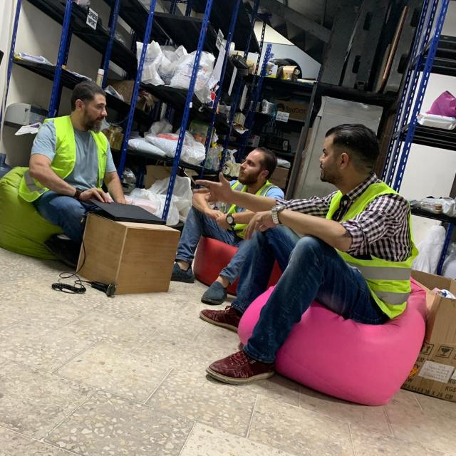

WE PROVIDE
concrete and reliable courier and freight forwarding services for local and foreign companies operating in the region.
WE HAVE
innate advantages in administering courier & freight Solutions.
WE ARE
able and ready to meet your short- and long-term contract needs .
WE VALUE
your time and we are here to support our clients from our first meeting to the last day of work.
WE ADAPT
in a fast paced and work intensive business environment with a communication strategy that keeps a constant relay between managers, employees, and clients for which our team is informed and accountable.

Slide 4
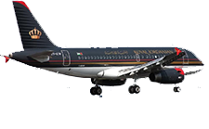
Wide Presence
Our wide presence in the market and shipping knowledge expertise had always been an asset to our customers as they believed that they are able to depend on us to provide them with our service for there shipments & logistics with a competitive price. Spex prides itself in being able to meet all the logistics needs of the customers.
More than 100 COUNTRIES

Slide 5

Our vision
is to be one of the big market leaders in the Logistics business providing a wide range of logistics services to our customers.
Mission
SPEX Express Company strive to be your preferred partner in the Logistics & supply chain in the communities where we operate. We combine economic success with social and environmental responsibility.

Slide 6

OUR SERVICES
Make Your Business Success
+100
+20K
95%
+100K
24/7
ACTIVE
COURIERS
INT.
SHIPMENTS
SUCCESS DELIVERY %
DELIVERED
SHIPMENTS
CS SUPPORT

Slide 7


OUR SERVICES
DOMESTIC
FREIGHT
EXPRESS
SPECIAL PROJECTS
Fulfilment Services
Our Domestic Express offers reliable door to door solutions for time-critical packages to be delivered within Jordan.
Our airfreight products encompass a complete range of advanced, high quality services provided globally
We will provide a global solution for importing and exporting time-sensitive documents and parcels door-to-door from around the world that will meet our customer’s needs
special handling operations team and delivery App to serve our client in operations level , empowering drivers and handling operations
Let us store your stock and deliver your goods to all cities of Jordan with less effort and more accuracy.

Slide 8

DOMESTIC SERVICES
Our Online Platform
Package Collect
Our online platform facilitates all our customer needs
Shipment are being picked from the suppliers upon request
Package Delivery
We offer next-business-day and same-day door-to-door delivery for your urgent domestic packages within Amman with a proof of delivery.
Return Service
Cash on Delivery
Send items and receive them back to customer doorstep. Ideal solution for getting documents signed or sending products that require repair and return.
We can deliver any product to our customers, collect the amount paid from the buyer, and then transfer the payment to our customer.

Slide 9
Domestic shipping is about moving goods from one place to another within the same country. ​​That much is obvious. But here’s something you might not know: sometimes shipping to a country’s territories is ​also considered part of domestic shipping.
Spex is one of the logistics providers offer you the domestic delivery service in Jordan.
Our team will follow up your shipments from the pick-up appointment to final destination in Jordan.
The domestic delivery is home to specific delivery services:
Delivery Operations: the delivery operation considers on overnight delivery. It’s fast next delivery service that delivers shipment in Jordan, the shipments are delivered the day after they are dropped off at Spex location from the customer.
Projects operations: special handling operations team and delivery App to serve our client in operations level.
Direct delivery operations: spex offers the on-demand delivery by expert team specialized in express delivery.
Delivery solutions and support :empowering drivers and handling operations to achieve KPI’s for our customers

Slide 10


24/7 CS SUPPORT
WHATSAPP
PHONE
We provide 24 hours WHATSAPP support, our new system provides direct responses using automated bot.
Our professional customer service team is always available to attend to your calls during working hours 9 AM-9 PM

Slide 11

Warehousing & Fulfillment Services
Well
01
Future
02
Segmented
Automation
Our warehouse is well segmented to assure no shipments out of track
We have prepare and instruct the first full automated warehouse with fulfillment system that can automate the process.
Assure
03
Maintain
04
Security
Condition
Our warehouse is secured with cameras and security systems that records and secures your shipments 24/7
If you’re shipping products that need specific temperature or that might break, our warehouse is designed to keep your products safe.

Slide 12
EXPORT EXPRESS
PRIORITY EXPRESS
We will Ship urgent packages around the world through Priority Express. Documents or parcels will be carefully packed, swiftly shipped and attentively cleared through customs to arrive on time to any global destination.
SAVING EXPRESS
For less urgent heavy packages, we will offer Eco Express, a time-definite delivery solution that enables customer to ship and send packages around the world at more economical rates than Priority Express.
MUST PROVIDE
- Online Shipping and real-time tracking updates.
- Proof of Delivery.
- Delivery notifications via e-mail and SMS.
- Customs clearance and a wide range of non-standard export and Clearance services.
12

Slide 13
IMPORT EXPRESS
Online Importing
We will offer our customers a smart tools to track your imports, and tools to import packages from customer global suppliers by contact us.
We will provide a global solution for importing time-sensitive documents and parcels door-to-door from around the world that will meet our customer’s needs.
Priority Import Express
door-to-door solution for your urgent packages.
Eco Import Express
For less urgent shipments, Eco Import Express is a cost-efficient delivery alternative that balances a great price with a longer delivery time.

Slide 14


AIR FREIGHT
Our airfreight products encompass a complete range of advanced, high
quality services provided globally.
6 Years of Experience
Our experience in scheduling and clearance procedures combined with our network of offices and selection of premium airfreight carriers, affords maximum presence with optimum connections thus enabling our customers to save time and money.
Meeting customer requirements
This is a result of analyzing our customer’s requirements permanently and developing products/ services to suit their needs. We offer both Priority and Economy Services, Groupage, Sea /Air Multimodal and Charter Services, in addition to our Door to Door Services , Our Network of agents give us access to worldwide stations and make it for our customers a one stop shop solution.

Slide 15
SEA FREIGHT
Whether it’s Full Container Loads (FCL), Less Than Container Loads (LCL), import or export, consolidated or project cargo – whatever your requirements may be, we will provide comprehensive ocean freight forwarding services. Backed by our relations & network of freight forwarders and key shipping lines, our ocean freight services will take care of your cargo through the entire shipping cycle, from collection to the delivery to the ultimate consignees.
FCL & LCL to and from all major markets
Customs Clearance and Door Delivery
Container stripping / break bulk
Full customs brokerage service
Real time information systems and Product insurance programs
Full documentation
service

Slide 16
ROAD FREIGHT
02
01
03
COST EFFECIENCY
RELIABILITY
VARIETY
We have some of the most cost-effective land transport solutions available, that ensure maximum efficient for our clients when it comes to delivering their products and services to their respective markets.
We provide reliable and fast road transport services throughout UAE and GCC and neighboring countries as well.
Door-to-door forwarding services by road are virtually available from any point to anywhere with-in the middle-east.

Slide 17
Objectives
100%
95%
85%
70%
AUTOMATION &
TECHNOLOGY
RESPONSIVENESS &
PRODUCTIVITY
GREEN &
SOCIAL RESPONSIBILTY
QUALITY &
EXCELLENCE
Maintaining a good responsiveness, productivity, and cost rate has been always the biggest tradeoff in the logistics market, our future plan includes raising the responsiveness to 100% to improve the market frontier in Jordan
Green is one main part of our vision, our social responsibility initiations encounter education, environment, and voluntary work
We are currently tracking our internal initiations to achieve great scores of excellence. Tracing our enablers and results is done through a qualified team leaded by certified EFQM assessors to apply for Excellence Awards
Our entity is the first socio-technical logistics firm that has a special investment program in technology that raises accuracy, intimacy, and efficiency

Slide 18

OUR ONLINE PLATFORM
User Friendly
75%
Our system is designed to be user friendly, we are currently developing our app for the best optimization.
Direct Update
99%
We provide direct updates about the shipments. Couriers assign the shipments to its final status on site.
Accuracy and tasks
99%
The data is accurate to provide the customers with full data about their shipments and finance status.

Slide 19

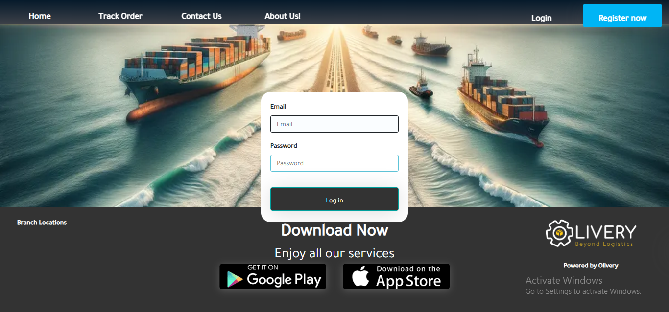
OUR ONLINE TRACKING SYSTEM
Track & Trace
We will pick up and deliver the packages within agreed delivery times with the ability to track your shipments online at any time, we will use our cars for Amman city limits and for remote areas.

Slide 20


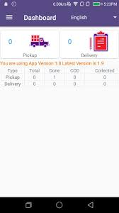
99%
Easy To Use
SPEX APP
Covering All Services
100%
100%
Responsiveness

Slide 21
CAN WE DELIVER TO SPACE?!
CREATIVITY &
INNOVATION
EDUCATION &
KNOWLEDGE TRANSFER
We have set the key elements needed to foster innovation and creativity, through workshops, implementation, and ongoing development
Education is one of the key elements that manage the development cycle we have a clear plan how to educate and transfer the knowledge internally and externally
HARD WORK &
DECIPLINE
TRAINING &
EMPOWERMENT
Our employees loyalty and intimacy builds our core motto of discipline and hard work.
Empowering our employees by professional training and clear instructions to take right decisions to raise productivity.

Slide 22
AUTOMATION & AI
Investment Objectives
Humanoid Robot Investment
Our professional team will study the technological needs and brain storm the ideas to reach to the best decision that matches
Our investment in humanoid robots is a major key to accomplish our objectives
Remote Agents
Smart Warehouse
Remote agents are one of our key factors to enhance productivity and overcome the productivity VS responsiveness tradeoff
Our warehouse ability and infrastructure to foster the development cycle of supply chain
Customized System
User Friendly App
Owning a customized system that attends to every need of our customers will eventually boost our performance
Our customers ability to accomplish all the transactions through a single app

Slide 23

Our Branches
Spex Expands Logistics Network with New Branches in Turkey, Saudi Arabia,
Spex is proud to announce the opening of new logistics branches in Turkey as the sales office , Saudi Arabia as full operation level , strengthening our global supply chain capabilities. This strategic expansion enhances our ability to provide express courier service, First mile and last mile delivery , warehousing, and distribution solutions across key markets in the Middle East

Slide 24


With these new locations, we aim to
Offer customized logistics solutions for regional businesses
Improve delivery efficiency and reduce transit times
Strengthen cross-border trade support
Our commitment to innovation and customer excellence continues as we grow our vision in these dynamic markets

Slide 25













Are Our Business Partners
OUR CUSTOMERS

Slide 26
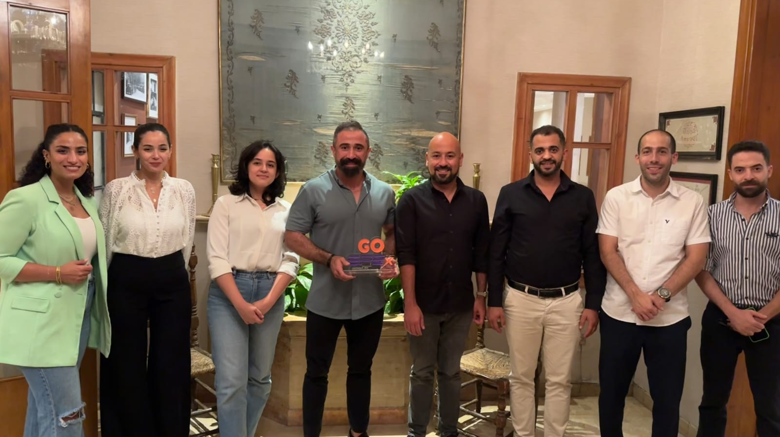
IF EVERYONE IS MOVING
FORWARD TOGETHER THEN
SUCCESSTAKES CARE OF ITSELF

Slide 27

CONTACT
We will consider your communication highly appreciated, our on-call team will forward you to the concerned person.
Contact
Sweifieh Wakalat Street
Open: 9am – 8pm
info@spex.me
+962799710001

